Slide 1
Catapult
By: group D

Slide 2
content
Jimmy
introduction of catapult
Jay
basic theory of Mangonel
Crystal
pros & cons
Luke
Gantt chart & our design

Slide 3
Introduction of catapult

Slide 4
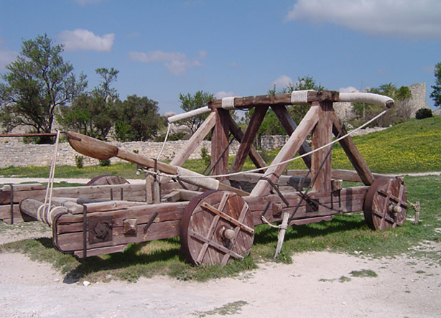
What is the catapult?
Catapult is the effective siege-work in the ancient.
There are three mainly type of catapult.
Ballista
Mangonel
Trebuchet

Slide 5
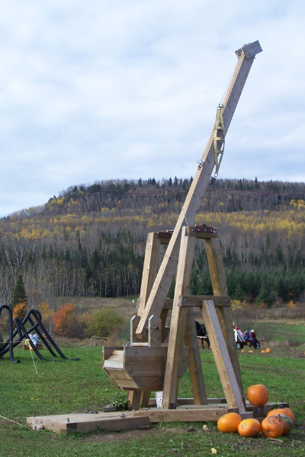
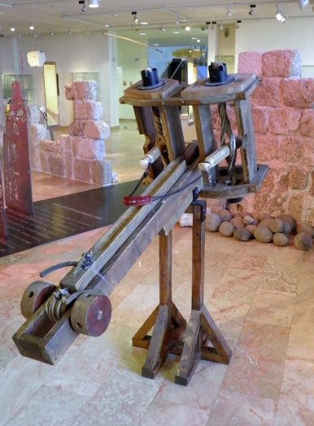
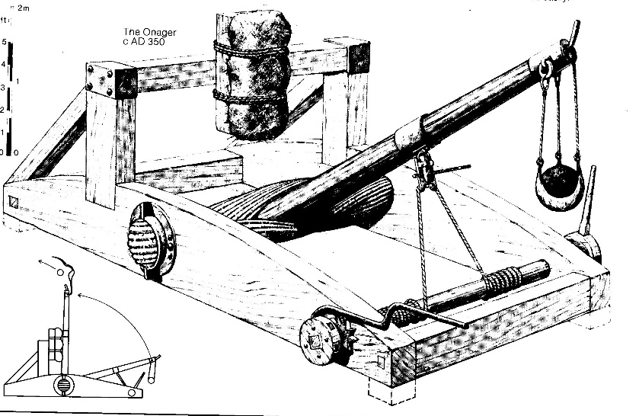
Examples of catapult

Slide 6

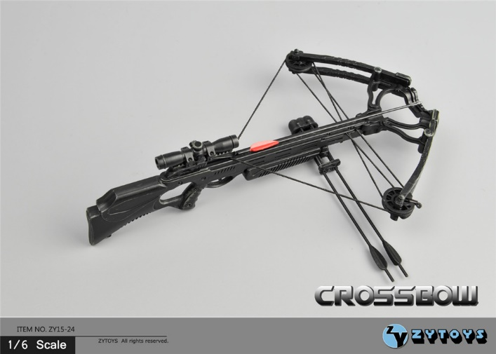
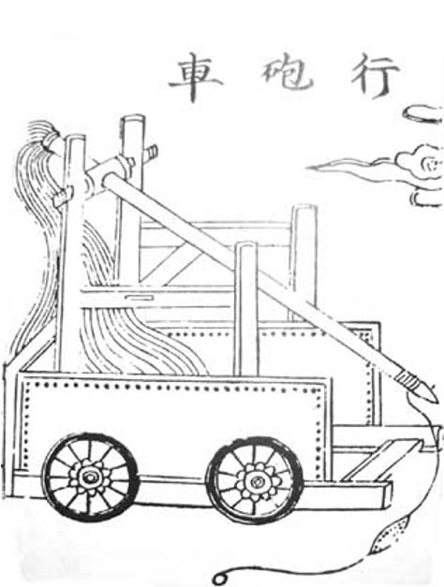
The history of catapult
The catapult is the upgrade of the crossbow.

Slide 7
During the war
The catapult can be used by the offensive or the defender.
AS offensive :break the city wall
As defender :destroy the siege-work or attack the offensive soldier

Slide 8
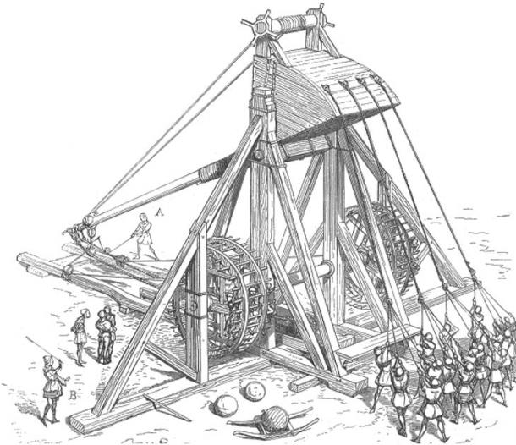
In the west
Western people design the other type of catapult (torsion catapult)
Onager
Mangonel

Slide 9
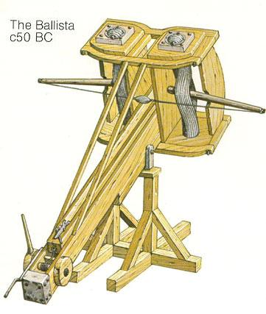
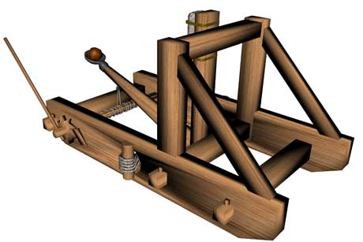
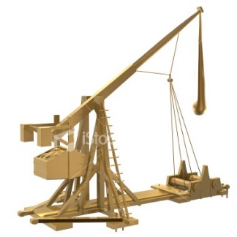
Time comparing
Ballista -------50 BC-------In Romans
Mangonel -----400 BC------In Romans
Trebuchet------400 BC-------In China

Slide 10
The basic theory of Mangonel

Slide 11
Mangonel Model
Wooden Structure
Ball
Rubber band
Mass of Ball ( m )
Bearing

Slide 12
The physical property of every part
The Rubber Band: Provide launch force. Change the Elastic Potential energy to the Kinetic energy. The stiffness factor is a constant K.
Hooke's law: F = k * s
The wooden structure: Limit the launch angel, which is fixed to θ = 45 degree.

Slide 13
The ideal launch function
The variable value in this model is the strain distance of the rubber band.
projectile distance ( S ) ∝ strain distance ( s )
The launch energy equal to the elastic potential energy.
E = F * s = 1/2 * k * s ^ 2
The projectile distance ( S ) can be solved using resolution of the force.

Slide 14
Calculus

Slide 15
Pros and cons

Slide 16
Trebuchet
Advantages
  long distance
  use the counter weight for power
Disadvantages
  huge amount of materials to build
  slow to operate
  difficult to control

Slide 17
Ballista
Advantages
  accurate
  provide support for soldier
Disadvantages
  not efficient
  not long range

Slide 18
Mangonel
Advantages
  light
  less materials to build
  throw rock and fire
Disadvantages
  not accurate
  consume the component

Slide 19
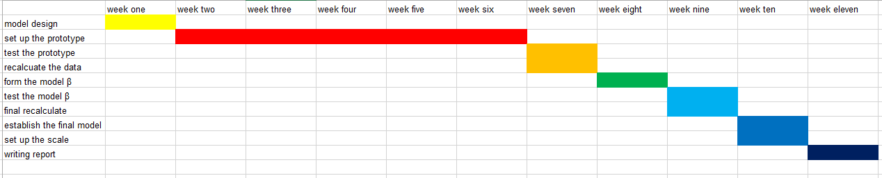
Gantt chart

Slide 20
why do we need a better design

Slide 21
Original design
The flap of the launcher is fixed (unable to adjust)
Using hemp rope for the spring (unstable)
Launch the rock as far as possible (inaccurate to reach specific distance)

Slide 22
Our design
the flap is able to move for the launcher can launch the rock with different angle
Change the materials for spring to get more for throwing arm
use the scale for specific distance that should be launch

Slide 23
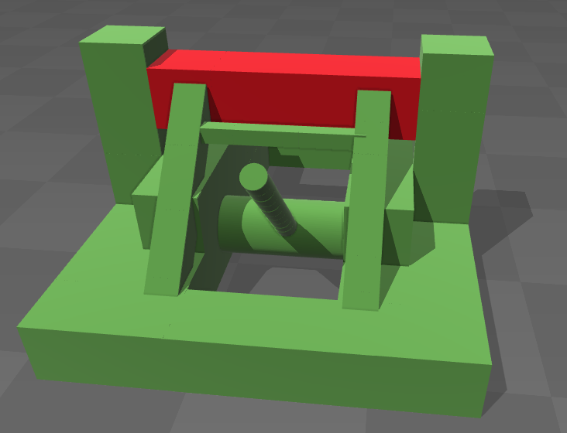
the flap is able to move for the launcher can launch the rock with different angle

Slide 24
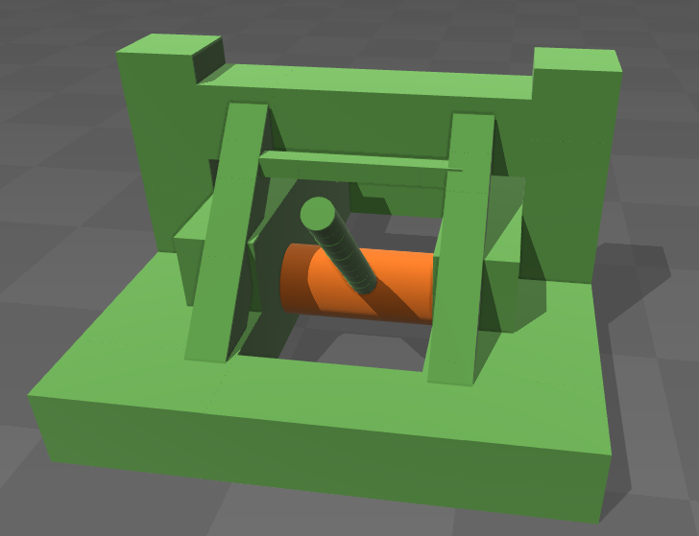
Change the materials for spindle to get more stable launching

Slide 25
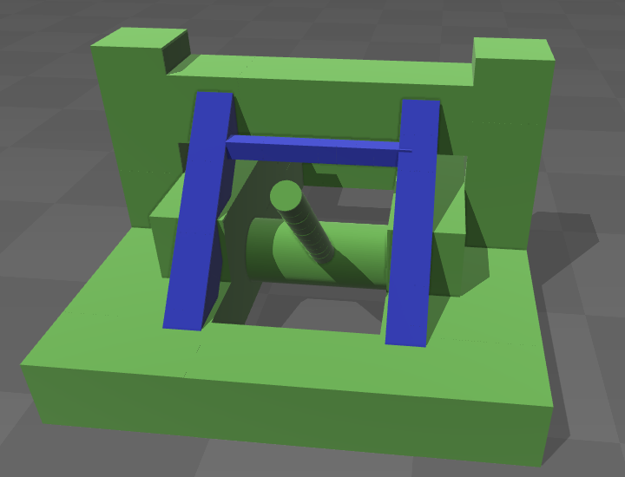
use the scale for specific distance that should be launch

Slide 26
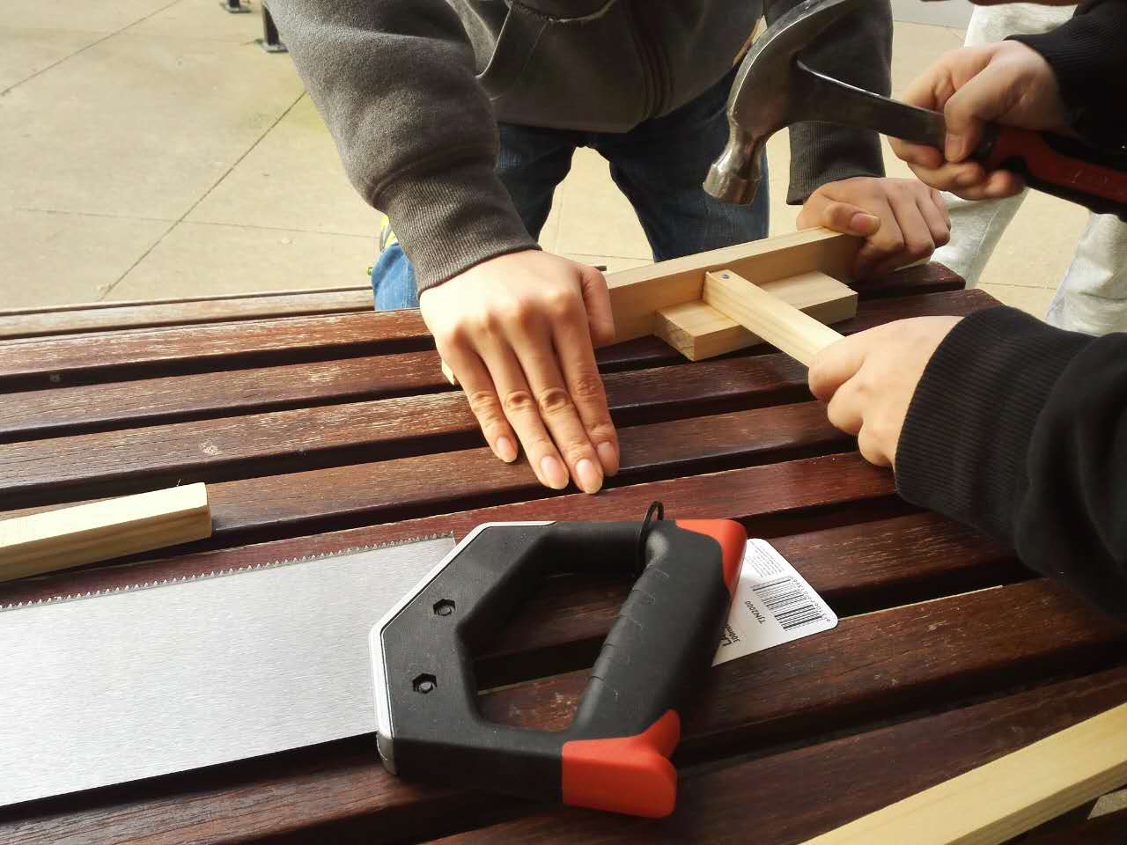
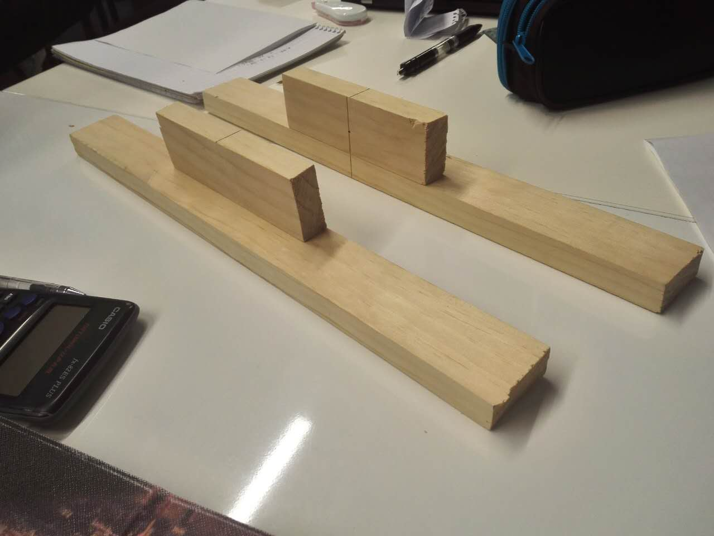
Progress of our catapult

Slide 27
conclusion
We base on the mangonel type of catapult
we have introduction for mangonel
Our design

Slide 28
Refference
http://754679356745456741.weebly.com/history-and-disadvantagesadvantages.html
https://answers.yahoo.com/question/index?qid=20090831105858AAbFw4a
https://prezi.com/vfqkaaumg5z8/ballista-vs-crossbow/
http://allaboutcatapults.blogspot.com.au/2012/06/mangonel.html
http://brekkas.tripod.com/man.htm
https://au.pinterest.com/pin/541346817685933898/
http://www.stormthecastle.com/catapult/the-history-of-the-catapult.htm
http://image.baidu.com/
https://sites.google.com/site/physicsofcatapults/home/history-of-catapults

